Slide 1
Smithy
A ‘Monster Hunter: Rise’ Discord Bot
by Trevor Kling

Slide 2
Introduction

Slide 3
Why this?
Discord
Lightweight text/audio chat service
~140 million monthly active users, ~6.7 million active servers
Market valuation: $7 billion USD^{[1]}
Monster Hunter
Game franchise developed by Capcom Co., Ltd.
‘Monster Hunter: World’ - 16.8 million copies sold^{[2]}
‘Monster Hunter: Rise’ - 6+ million copies sold since March 26^{[3]}
[1] Discord Revenue and Usage Statistics (2021). Business of Apps. (2021, May 6). https://www.businessofapps.com/data/discord-statistics/.
[2] CAPCOM: Platinum Titles. CAPCOM IR. (n.d.). https://www.capcom.co.jp/ir/english/finance/million.html.
[3] MONSTER HUNTER RISE: CAPCOM. Monster Hunter Portal. (n.d.). https://www.monsterhunter.com/rise/us/topics/itempack/.

Slide 4
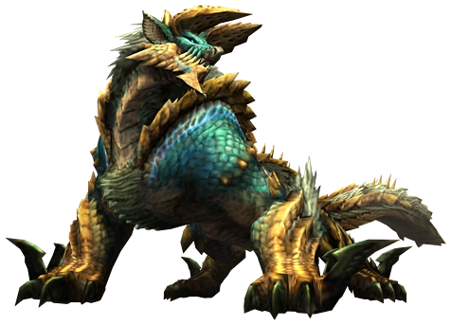
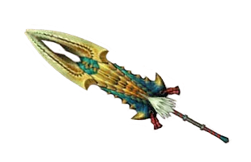
Gameplay Loop

Slide 5
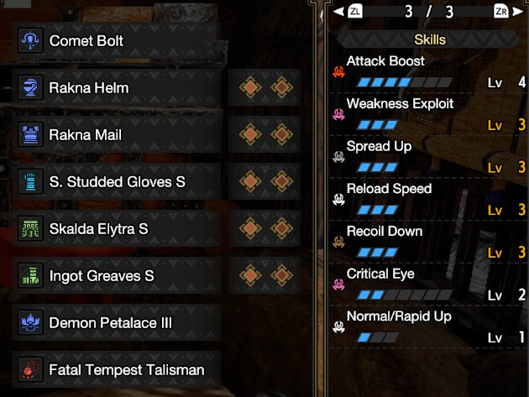
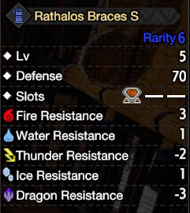
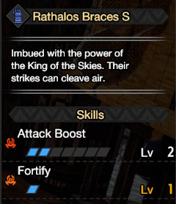
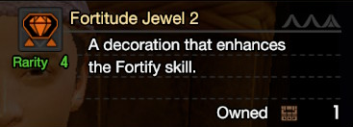
Armor Sets

Slide 6
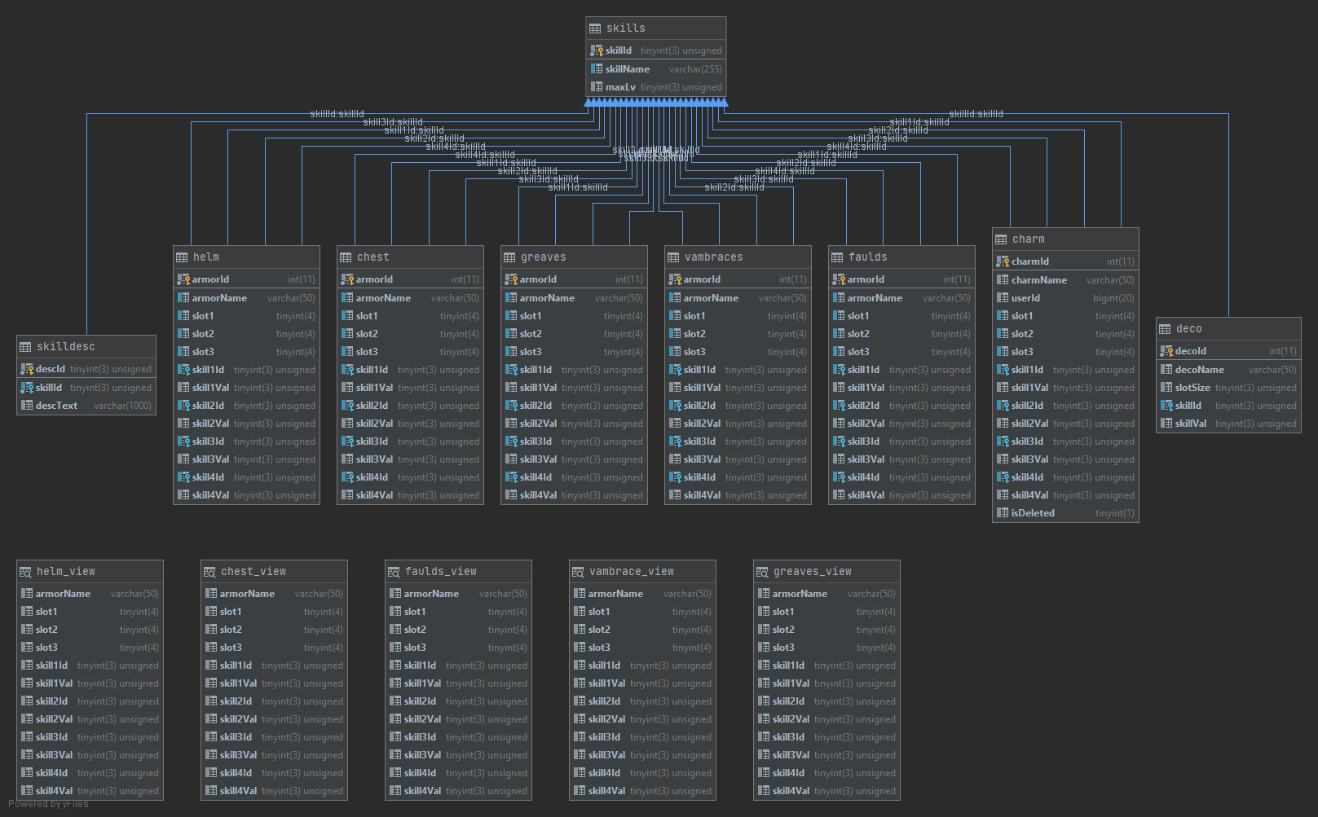

Slide 7
Demo

Slide 8
The “!build” command

Slide 9
Problem Analysis
Combinatorial Optimization
Specifically, a Constraint Satisfaction Problem
Often involve high complexity
Search space likely scales like O(n⁵)
Left joins across 24 total tables
Dynamically Produced Queries
Number and value of skills requested can vary
User-given maximum skill values
Discord Bot
Attempting to simulate human interaction
Performance > Accuracy in many scenarios

Slide 10
Heuristics and Optimizations
Subqueries
Remove all armor pieces not containing a desired skill or decoration slot before joining
Similar process with decorations
Artificially restrict search space
Most likely candidates will have the skills already on the armor, not included via decorations.
Sort candidates by skill value provided then by slots available
Only return num_results options prior to joins (good performance with 3-4 pieces)

Slide 11
Future Improvements

Slide 12
Avenues for Improvement
Characterization of the bot
Improve display formatting
Include more robust sorting methods
Introduce total Defense as a tiebreaker between sets providing same skills
Improve information querying methods
Skill Descriptions
Armor images
Fuzzy skill name matching
Add command categories

Slide 13
Thanks for listening!

